Slide 1

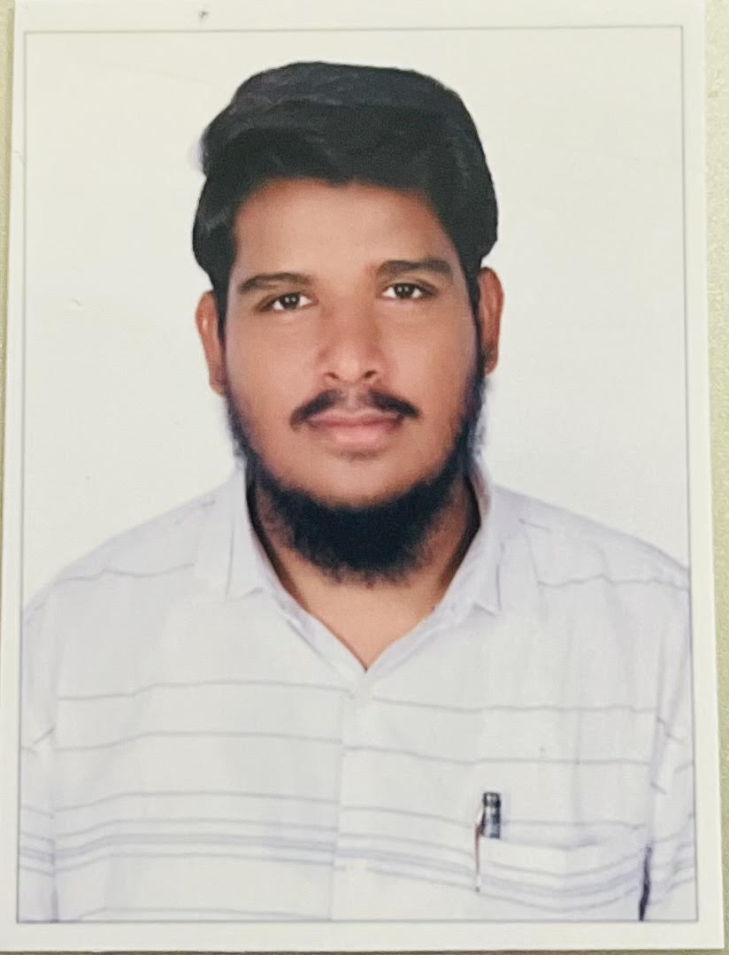





Shaik Shafivulla
Education and certificates
Bachelor of Technology Computer Science : 2017 - 2021
Analyst/Software Engineer
Skills
C
C++
Python
DevOps-Basics
C#Sharp
Base Location:BLR
Email ID:
Shaik.Shafivulla@capgemini.com
_{Mobile No:} +91 6302214406
Grade:
A4
Strengths
A self driven learner with Front-End and Back-End knowledge. Passionate about implementing and launching new projects.
Ready to learn new technologies/Frameworks and implement them to further improve my knowledge.
A team player with good communication skill always ready to work for the enrichment of knowledge.
Has working knowledge on Angular and Java Microservice Development using Spring framework on an intermediate level.
Achivement
Hotel Management System Application
Database
SQL database – MySQL
Web Technologies
HTML5
XML
Completed end to end case study of Hotel Management System along with JWT authentication, Swagger and Billing System using Spring boot Microservices with Eureka Server. Semantic UI and Angular used for user interface.
Additional Details
Excellent Communication Skills
Team Player
Coded and designed Static Web Pages
Developed website with HTML5 and CSS3 Along Frameworks like SASS(Syntactically awesome style sheets) to make website more interactive and dynamic.
Coded website for Resources used in Front-End
Development
Also Implemented Eureka Server and Semantic UI in case study and upskilling day by day.
Completed Designed and coded a website for the Resources used for making website like images,fonts,icons etc. LINK
:- https://sad-bardeen-ceb858.netlify.app/
Check out my work on GitHub & Video Profile
Presentation Title | Author | Date © Capgemini 2017. All rights reserved | 1

